Slide 1
Research Platform for Custom Memory Cube
Dr. Herman Lam
Assoc. Professor of ECE
University of Florida
Yu Zou
Vinayak Deshpande
Jeshalraj Thakaria

Slide 2
Outline
Brief review & overview
Performance measurements on Merlin board
Mapping notional CMC to Merlin board
Validation of performance measurements on Merlin board
Validation using HMC simulator from Micron
Experiment 1
Experiment 2
Application exploration using HT
Bloom filter examples
Bucket sorting examples
Going forward

Slide 3
Outline
Brief review & overview
Performance measurements on Merlin board
Mapping notional CMC to Merlin board
Validation of performance measurements on Merlin board
Validation using HMC simulator from Micron
Experiment 1
Experiment 2
Application exploration using HT
Bloom filter examples
Bucket sorting examples
Going forward

Slide 4
Performance Measurement on Merlin Board
CMC platform on Merlin board
Instrumented Merlin infrastructure with hardware performance monitors
A’, B’, C’, D’, M1, M2, M3, M4, and M5.
Progress: Able to measure all listed parameters except:
M4, M5: not instrumented currently; if necessary, will seek help from Convey

Slide 5
Mapping Notional CMC onto Merlin Board
Merlin board
Case study: model of a notional CMC*
Simplifying assumption:
For this model, this part of CMC is assumed to have an HMC architecture
Observation:
“Pipelining” effect of overlapping memory access
* Nair, R., et al. "Active Memory Cube: A processing-in-memory architecture for exascale systems.“ IBM Journal of Res. & Development 59.2/3 (2015): 17-1.

Slide 6
Observation: Overlapping Memory Access
For overlapping read/write ops:
Measurements at M1, M2, M3, (M4, M5, E’) have no significant difference

Slide 7
Overlapping Memory Access: DRE ops
Observation: M1, M2, M3, (M4, M5, E’) again have no significant difference
For overlapping memory access, discrepancy between M1, M2, M3, (M4, M5, E’) is hidden by “pipeline effect”
Thus, for overlapping memory access, we will use measurements at M3 in this presentation.

Slide 8
Outline
Brief review & overview
Performance measurements on Merlin board
Mapping notional CMC to Merlin board
Validation of performance measurements on Merlin board
Validation using HMC simulator from Micron
Experiment 1 – blocking memory access
Experiment 2 – pipelined memory access
Application exploration using HT
Bloom filter examples
Going forward
HT Programming Basics

Slide 9
Validation Experiments
Validation of performance measurement on Merlin board
Approach
Compare Merlin board measurement vs. Micron HMC SystemC simulator results
vs.
Experiments:
Blocking memory access pattern
Comparison of average latency of single memory access
Pipelined memory access pattern
Comparison of average latency of single memory access
Comparison of total overlapping latency

Slide 10
Exp. 1: Average Latency, Blocking Access
Measurement on Merlin board
3. Avg. latency reported in SystemC Simulator
2. Measure latency of each single memory access at M3; Calculate average (e.g. 100,000 accesses) latency
4. Compare
Simulation on HMC Simulator
1. Input (e.g. 100,000) blocking memory requests

Slide 11
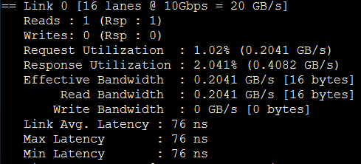
Exp. 1 Results: SystemC Simulator & Merlin Board
Results from SystemC Simulator
Avg latency: 76 ns
Simulator clock frequency: 625MHz
Avg latency: 47.5 sim clock cycles
Avg. Latency measured on Merlin board
Avg latency: 460~500 ns
Board clock frequency: 167MHz
Avg latency: 76~83 board clock cycles
Notes:
Bottom graph: what is the X axis (1 – 10)? I thought we have 100,000 blocking inputs.
Since you put “clk frequency” and “clock cycles” for average latency for the bottom graph, you should do the same for the top graph.
In fact, you should label “clk frequency” and “clock cycles” with either “simulator” or “board” (e.g., board clock cycles)

Slide 12
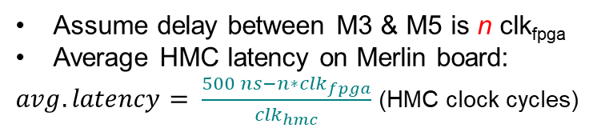
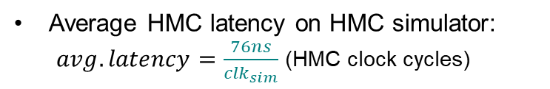
Exp. 1: Analysis of Results
Merlin Board
HMC Simulator
Clk freq:
freq_{fpga} = 167MHz (6ns/clk)
freq_{hmc} = 333MHz (3ns/clk)
freq_{sim} = 625MHz (1.6ns/clk)
Assume delay between M3 & M5 is n clk_{fpga}
Average HMC latency on Merlin board:
$avg. latency= \frac{500 ns−n∗{clk}_{fpga}}{{clk}_{hmc}}$ (HMC clock cycles)
Average HMC latency on HMC simulator:
$avg. latency=\frac{76ns}{{clk}_{sim}}$ (HMC clock cycles)
*
**
?
$\frac{500 ns−n∗{clk}_{fpga}}{{clk}_{hmc}}=\frac{76 ns}{{clk}_{sim}}$ => n = 59.6 fpga clock cycles
Next step: Using Synopsys VCS (RTL simulator), to validate n ~ 52.9 to 59.6
* From previous slide, the average latency of the board is actually 460 to 500 ns, calculation is for 500 ns.
** For average latency of 460, n = 52.9; thus, n is between 52.9 to 59.6.
Notes:
I inserted the footnote. Please verify.
When I worked out the equation for n (using 500), I get n = 59.6 not 58. Please verify your calculation.
Verify my calculation for average latency of 460 which has n ~ 52.9.

Slide 13
Exp. 1: Using Synopsys VCS to Validate n
Merlin Board
HMC Simulator
Clk freq.
freq_{fpga} = 167MHz (6ns/clk)
freq_{hmc} = 333MHz (3ns/clk)
freq_{sim} = 625MHz (1.6ns/clk)
Ongoing work:
Determine accurate M3 – M4 delay:
Setting up RTL simulation of Merlin infrastructure code
Working on getting Synopsys VCS license
M4 – M5 delay:
Contact Altera for information on HMCC module

Slide 14
Exp. 2a: Average Latency, Pipelined Access
Measurement on Merlin board
3. Avg. latency reported in SystemC Simulator
2. Measure latency of each single memory access at M3; Calculate average (e.g. 100,000 accesses) latency
4. Compare
Simulation on HMC Simulator
1. Input (e.g. 100,000) pipelined memory requests

Slide 15
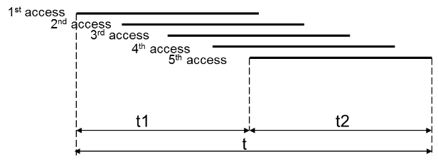
Exp. 2b: Total Latency, Pipelined Access
Measurement on Merlin board
Recall (Slide 7)
In overlapping access
M1 = M2 = M3 = (M4 = M5)
For HMC
M5 = C (from simulator)
Measure T (total latency) at M3 (T_{measure}) & C (T_{sim}), and compare T_{measure} and T_{sim}
D
L
T
Simulation on HMC Simulator
1. Input (e.g. 100,000) pipelined memory requests

Slide 16
Exp. 2a Results – Average Latency
Merlin board
HMC simulation
Observations:
Average latency on Merlin board larger than from simulator
Average latency on Merlin board is nondeterministic
Thus, Merlin board result is not consistent with expected result (from simulator)
Analysis:
Small FIFO size in HT infrastructure limits pipelined memory requests
M3 includes extra HT infrastructure logic, delay of which is nondeterministic
Current work:
Increase FIFO size of Merlin infrastructure to fully utilize HMC bandwidth
Notes:
Please verify changes

Slide 17
Exp. 2b Results – Total Latency
Merlin board
HMC simulation
Observation:
Trend of measured result is consistent with that of simulator, up to 15,000 requests (simulator is limited to max number of 15,000 requests)
Analysis:
Exp. 2b does not prove the actual numbers (for total latency) are accurate; but does show consistent trend
Actual numbers to be validated after increasing FIFO size of Merlin infrastructure
Current work:
Increase FIFO size of Merlin infrastructure to fully utilize HMC bandwidth
Notes:
Please verify changes

Slide 18
Outline
Brief review & overview
Performance measurements on Merlin board
Mapping notional CMC to Merlin board
Validation of performance measurements on Merlin board
Validation using HMC simulator from Micron
Experiment 1
Experiment 2
Application exploration using HT
Bloom filter examples
Sorting examples
Going forward
HT Programming Basics
* DRE: Data rearrangement/reordering engine ** CMC Computational Memory Cube

Slide 19
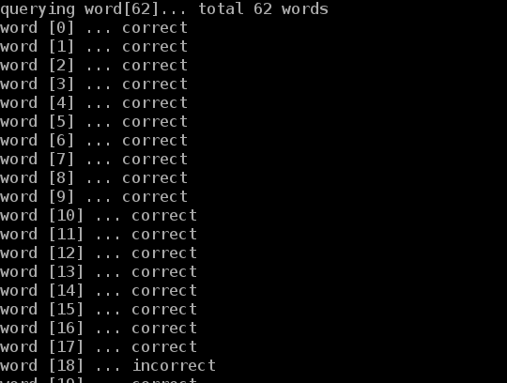
Bloom Filter HT Demos
Spell checker
Input
A dictionary
Words to check
Function
A bloom filter was pre-set using the dictionary
A new word was compared against bloom filter to check existence in the dictionary
Output
A wrong spelling is reported if the new word doesn’t exist in bloom filter
HT utilization
1 HT unit

Slide 20
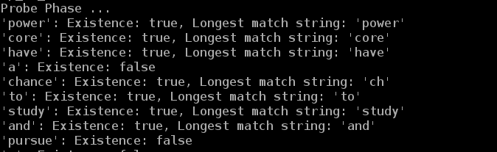
Bloom Filter HT Demos
Content-based deep packet inspection (longest string match)
Input
A group of different-length sensitive words
Packet to inspect
Function
All same-length sensitive words are used to set the same bloom filter
Multiple bloom filters are pre-set
A new packet is compared against bloom filters to check existence of sensitive words
Output
Report the packet contains sensitive information, if matched
HT utilization
16 HT units

Slide 21
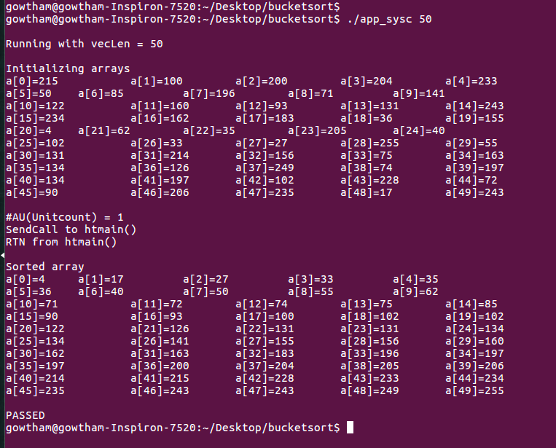
Bucket Sort HT Demos
Sorting an array of numbers
Input
Array length (Maximum 1024)
Function
Array is initialized with random uniformly distributed integers between 0-256
Numbers are distributed to the buckets
Each bucket is sorted individually
Sorted buckets are concatenated to obtain the sorted array
Output
Sorted array is reported
HT utilization
1 HT unit

Slide 22
Going Forward
Platform development
Continue validation of CMC platform
Continue development & instrumentation of CMC platform
Develop library for customization of notional CMC architecture under study
Create user-friendly CMC API
Case studies to explore
Explore CMC apps using HT; apps, includes:
Data Reordering/Rearrangement Engine, sorting algorithms, bloom filter
Notional CMC architectures
Lessons learned, including:
Characteristics of CMC-amenable apps
How to re-factor algorithms to become CMC-amenable
Notes:
Please verify changes

